Slide 1
Information Retrieval
Relevance

Slide 2
Introduction
Information Retrieval (IR) is a field of science concerned with searching for useful information in large, loosely structured or unstructured collections.
In the 1970s, when the field was in its early stages, the word information primarily meant text, specifically the kinds of text one might find in a library.
Today information exists in many more forms, often quite different from books or scientific articles which were the focus of early retrieval systems.
Web searching is well known application of information retrieval today, and on the web we may find relevant information in the form of
text,
images,
audio files,
video segments,
even as hyper-links between various pages.

Slide 3
Introduction
Modern search system must
find,
organize and
present
to the user all of these very different form of information, because all of them may have some relevance to the user’s information need.

Slide 4
Relevance
The notion of relevance serves as the foundation for the field of Information Retrieval.
In literature some scientists went so far as to say that it defines the entire field and serves as a distinguishing feature from database theory and library science.
Since the purpose of retrieval systems is to retrieve relevant items in response to user requests it is important to spend time on the definiton of Relevance.

Slide 5
Relevance
Usually, most users have an idea of what relevance is – it is a representation of their information need, a reflection of what they are searching for.
However, in order to build and test effective retrieval systems one must translate the intuitive notion of relevance into a strict formalism. (challenge)

Slide 6
A simple definition of relevance
The most widely used, definition of relevance is:
A binary relation between a given information item (document D) and the user’s request (query Q).
Assume that the document is represented by a set of key words, appropriately reflecting its contents.
Similarly, the user’s request Q is a set of key words that represent the user’s interest

Slide 7
System-Oriented Definition of Relevance
Given these representations, we may say that a relevance relation between D and Q holds if there is a substantial overlap in meaning between the keyword sets of D and Q. (system-oriented)

Slide 8
Cooper’s Definition of Relevance
A document D is considered relevant to the request if it contains at least one sentence s that is relevant to q.
This definition makes it reasonable to allow that documents may discuss different topics and that a single document may be relevant to very different requests.

Slide 9
The binary nature of relevance
In most definitions relevance takes a form of a binary relation between a document and a query – a document is either relevant or it is not.

Slide 10
Dependent and independent relevance
Most operational systems assume that relevance of a given document is independent of any other document already examined by the user or of any.

Slide 11
Relevance and novelty (Redundancy)
If a collection contains two near-duplicate documents the user is unlikely to be interested in reading both of them.
They both may be topically relevant to the request, but once one of them is discovered, the second one may become entirely redundant, and irrelevant for information seeking purposes.

Slide 12
Relevance of a set of documents
If the information need of the user is sufficiently complex, it may be possible that no individual document completely satisfies that need by itself.
However, information pooled from several documents may be sufficient.

Slide 13
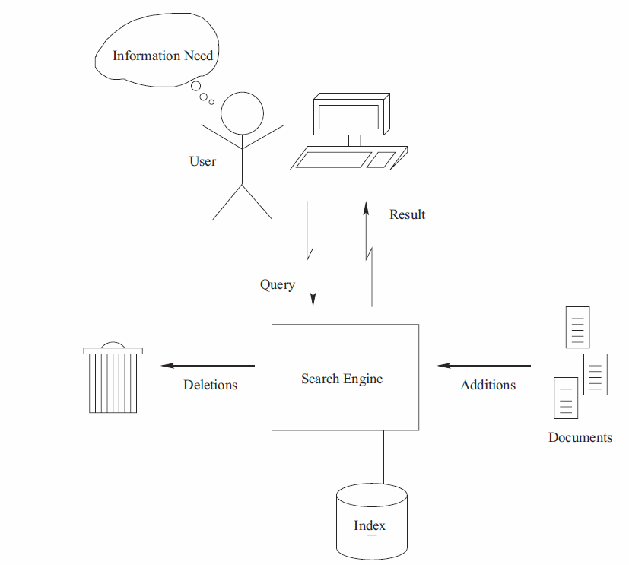
Basic IR System Architecture
Before conducting a search, a user
has an information need, which drives the search process
Sometimes refered to this information need as a topic, particularly when it is presented in written form as part of a test collection for IR evaluation
As a result of her information need, the user constructs
and issues a query to the IR system.
Typically, this query consists of a small number of terms,
with two to three terms being typical for a Web search
the “term” is used instead of “word”, because a query term may in fact not be a word at all.
Depending on the information need, a query term may be a date, a number, a musical note, or a phrase.

Slide 14
Basic IR System Architecture
Wildcard operators and other partial-match operators may also be permitted in query terms.
For example, the term
“inform*” might match any word starting with that prefix (“inform”, “informs”, “informal”, “informant”, “informative”)
Although users typically issue simple keyword queries, IR systems often support a richer query syntax, frequently with complex Boolean and pattern matching operators.
These facilities are used to limit a search to a particular Web site, to specify constraints on fields such as author and title, or to apply other filters, restricting the search to a subset of the collection.
The user’s query is processed by a search engine

Slide 15
Basic IR System Architecture
A major task of a search engine is to maintain and manipulate an inverted index for a document collection.
This index forms the principal data structure used by the engine for searching and relevance ranking.
As its basic function, an inverted index provides a mapping between terms and the locations in the collection in which they occur.
Because the size of an inverted list is on the same order of magnitude as the document collection itself, care must be taken that index access and update operations are performed efficiently.

Slide 16
Basic IR System Architecture
To support relevance ranking algorithms, the search engine maintains collection statistics associated with the index, such as the number of documents containing each term and the length of each document.
In addition, the search engine usually has access to the original content of the documents, in order to report meaningful results back to the user.
Using the inverted index, collection statistics, and other data, the search engine accepts queries from its users, processes these queries, and returns ranked lists of results.

Slide 17
The retrieval process
Information need
Documents
Formulation
Indexing
Query
Document representation
Retrieval functions
(Comparisons)
Retrieved documents

Slide 18
Process of retrieving info
User Interface
Text
User feedback
User need
Text
Text Operations
Logical view
Logical view
Document Repository
Manager
Query Operations
Indexing
Query
Inverted file
Similarity Computation
Index
Text repository
Retrieved docs
Ranked docs
Ranking

Slide 19
Issues
Some issues that arise in IR
Text representation
what makes a “good” representation?
how is a representation generated from text?
what are retrievable objects and how are they organized?
Representing information needs
what is an appropriate query language?
how can interactive query formulation and refinement be supported?
Comparing representations
what is a “good” model of retrieval?
how is uncertainty represented?
Evaluating effectiveness of retrieval
what are good metrics?
what constitutes a good experimental test bed?

Slide 20
Types of Evaluation
IR system often component of larger system
Might evaluate several aspects
Assistance in formulating queries
Speed of retrieval
Resources required
Presentation of documents
Ability to find relevant documents
Appealing to users (market evaluation)
Evaluation generally comparative
System A vs. B or A vs A’
Cost-benefit analysis possible
Most common evaluation: retrieval effectiveness

Slide 21
Test Collections
Compare retrieval performance using a test collection
set of documents
set of queries
set of relevance judgments (which docs relevant to each query)
To compare the performance of two techniques:
each technique used to evaluate test queries
results (set or ranked list) compared using some performancemeasure
most common measures based on precision and recall
Usually test with multiple collections - performance is collection dependent

Slide 22
Retrieval Model
What Is a retrieval model?
Model is an idealization or abstraction of an actual process (here, retrieval)
Mathematical models are used to study the properties of the process, draw conclusions, make predictions
Conclusions derived from a model depend on whether the model is a good approximation of the actual situation
Statistical models represent repetitive processes , make predictions about frequencies of interesting events, use probability as the fundamental tool

Slide 23
What is a retrieval model?
Retrieval models can describe the computational process
– how documents are ranked
– Note that how documents or indexes are stored is implementation
Retrieval variables: queries, documents, terms, relevance judgements, users, information needs, …
Retrieval models have definition of relevance.

Slide 24
IR Model: Boolean (exact match)
Exact match retrieval
Dominant model for years
Still popular
Advantages:
efficient
predictable, easy to explain
structured queries
work well when you know exactly what docs you want

Slide 25
Exact Match (Boolean Model)
Exact-match
query specifies precise retrieval criteria
every document either matches or fails to match query
result is a set of documents
Unordered in pure exact match (set of documents)

Slide 26
Boolean Model
Most common exact-match model
queries: logic expressions with doc features as operands
retrieved documents are generally not ranked
query formulation difficult for novice users
“Pure” Boolean operators: AND, OR, and NOT
Most systems support simple regular expressions as search terms to match spelling variants

Slide 27
Boolean Model
Term-document incidence matrice
we have a 0/1 vector for each term.
Documents
(possibly document ids)
1: System and human system engineering testing of EPS
2: A survey of user opinion of computer system response time
3: The EPS user interface management system
4: Human machine interface for ABC computer applications
5: Relation of user perceived response time to error measurement
6: The generation of random, binary, ordered trees
7: The intersection graph of paths in trees
8: Graph minors IV: Widths of trees and well-quasi-ordering
9: Graph minors: A survey
 | 1 | 2 | 3 | 4 | 5 | 6 | 7 | 8 | 9
Interface | 0 | 0 | 1 | 0 | 0 | 0 | 0 | 0 | 0
User | 0 | 1 | 1 | 0 | 1 | 0 | 0 | 0 | 0
System | 1 | 1 | 1 | 0 | 0 | 0 | 0 | 0 | 0
Human | 1 | 0 | 0 | 1 | 0 | 0 | 0 | 0 | 0
Computer | 0 | 1 | 0 | 1 | 0 | 0 | 0 | 0 | 0
Response | 0 | 1 | 0 | 0 | 1 | 0 | 0 | 0 | 0
Time | 0 | 1 | 0 | 0 | 1 | 0 | 0 | 0 | 0
EPS | 1 | 0 | 1 | 0 | 0 | 0 | 0 | 0 | 0
Survey | 0 | 1 | 0 | 0 | 0 | 0 | 0 | 0 | 1
Trees | 0 | 0 | 0 | 0 | 0 | 1 | 1 | 1 | 0
Graph | 0 | 0 | 0 | 0 | 0 | 0 | 1 | 1 | 1
Minors | 0 | 0 | 0 | 0 | 0 | 0 | 0 | 1 | 1
term-document incidence matrix. Matrix element (t, d) is 1 if the
Document in column d contains the word in row t, and is 0 otherwise

Slide 28
Boolean Model
To answer query: take the vectors system AND computer
bitwise AND.
 | a | b | c | d | e | f | g | h | I
Interface | 0 | 0 | 1 | 0 | 0 | 0 | 0 | 0 | 0
User | 0 | 1 | 1 | 0 | 1 | 0 | 0 | 0 | 0
System | 1 | 1 | 1 | 0 | 0 | 0 | 0 | 0 | 0
Human | 1 | 0 | 0 | 1 | 0 | 0 | 0 | 0 | 0
Computer | 0 | 1 | 0 | 1 | 0 | 0 | 0 | 0 | 0
Response | 0 | 1 | 0 | 0 | 1 | 0 | 0 | 0 | 0
Time | 0 | 1 | 0 | 0 | 1 | 0 | 0 | 0 | 0
EPS | 1 | 0 | 1 | 0 | 0 | 0 | 0 | 0 | 0
Survey | 0 | 1 | 0 | 0 | 0 | 0 | 0 | 0 | 1
Trees | 0 | 0 | 0 | 0 | 0 | 1 | 1 | 1 | 0
Graph | 0 | 0 | 0 | 0 | 0 | 0 | 1 | 1 | 1
Minors | 0 | 0 | 0 | 0 | 0 | 0 | 0 | 1 | 1
Computer: 0 1 0 1 0 0 0 0 0
System : 1 1 1 0 0 0 0 0 0
Retrieved 0 1 0 0 0 0 0 0 0
Document

Slide 29
Issues
Consider N = 1 million documents, each with about 1000 words.
Avg 6 bytes/word including spaces/punctuation
6GB of data in the documents.
Say there are M = 500K distinct terms among
Can’t build the matrix (500K x 1M matrix )
But it has no more than one billion 1’s.
matrix is extremely sparse.
What’s a better representation?
We only record the 1 positions

Slide 30
Inverted index
 | a | b | c | d | e | f | g | h | I
Interface | 0 | 0 | 1 | 0 | 0 | 0 | 0 | 0 | 0
User | 0 | 1 | 1 | 0 | 1 | 0 | 0 | 0 | 0
System | 1 | 1 | 1 | 0 | 0 | 0 | 0 | 0 | 0
Human | 1 | 0 | 0 | 1 | 0 | 0 | 0 | 0 | 0
Computer | 0 | 1 | 0 | 1 | 0 | 0 | 0 | 0 | 0
Response | 0 | 1 | 0 | 0 | 1 | 0 | 0 | 0 | 0
Time | 0 | 1 | 0 | 0 | 1 | 0 | 0 | 0 | 0
EPS | 1 | 0 | 1 | 0 | 0 | 0 | 0 | 0 | 0
Survey | 0 | 1 | 0 | 0 | 0 | 0 | 0 | 0 | 1
Trees | 0 | 0 | 0 | 0 | 0 | 1 | 1 | 1 | 0
Graph | 0 | 0 | 0 | 0 | 0 | 0 | 1 | 1 | 1
Minors | 0 | 0 | 0 | 0 | 0 | 0 | 0 | 1 | 1
For each term t, we must store a list of all documents that contain t.
Identify each doc by a docID, a document serial number
Interface -> 3
User-> 2-> 3-> 5
System-> 1-> 2 -> 3
Dictionary
Sorted by docID.

Slide 31
Inverted index
We need variable-size postings lists
On disk, a continuous run of postings is normal and best
In memory, can use linked lists or variable length arrays
Some tradeoffs in size/ease of insertion

Slide 32
Common Improvements
The vector space model
Doesn’t handle morphology (eat, eats, eating)
Favors common terms
Possible fixes
Stemming
Convert each word to a common root form
Stop lists
Term weighting

Slide 33
Inverted index construction
Sec. 1.2
Documents to
be indexed
Friends, Romans, countrymen.
Tokenizer
Token stream
Friends
Romans
Countrymen
Linguistic modules
Modified tokens
friend
roman
countryman
Indexer
friend
2
4
roman
1
2
Inverted index
countryman
13
16

Slide 34
Initial stages of text processing
Tokenization
Cut character sequence into word tokens
Deal with “John’s”, a state-of-the-art solution
Normalization
Map text and query term to same form
You want U.S.A. and USA to match
Stemming
We may wish different forms of a root to match
authorize, authorization
Stop words
We may omit very common words (or not)
the, a, to, of

Slide 35
Indexer steps: Token sequence
Sec. 1.2
Sequence of (Modified token, Document ID) pairs.
Doc 1
Doc 2
I did enact Julius
Caesar I was killed
i’ the Capitol;
Brutus killed me.
So let it be with
Caesar. The noble
Brutus hath told you
Caesar was ambitious

Slide 36
Indexer steps: Sort
Sec. 1.2
Sort by terms
And then docID
Core indexing step

Slide 37
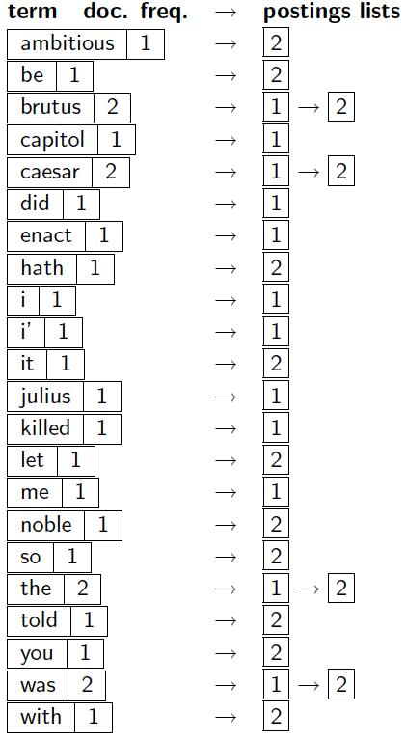
Indexer steps: Dictionary & Postings
Sec. 1.2
Multiple term entries in a single document are merged.
Split into Dictionary and Postings
Doc. frequency information is added.
Why frequency?
Will discuss later.

Slide 38
Where do we pay in storage?
Sec. 1.2
Lists of docIDs
Terms and counts
IR system implementation
How do we index efficiently?
How much storage do we need?
Pointers

